Slide 1
Experiences of PyCon UK 2013
Daley Chetwynd (@dchetwynd)
Software developer
ThoughtWorks

Slide 2
Contents
Introduction
Conference information
Daily sessions
Education track
Development sprints
Conclusions

Slide 3
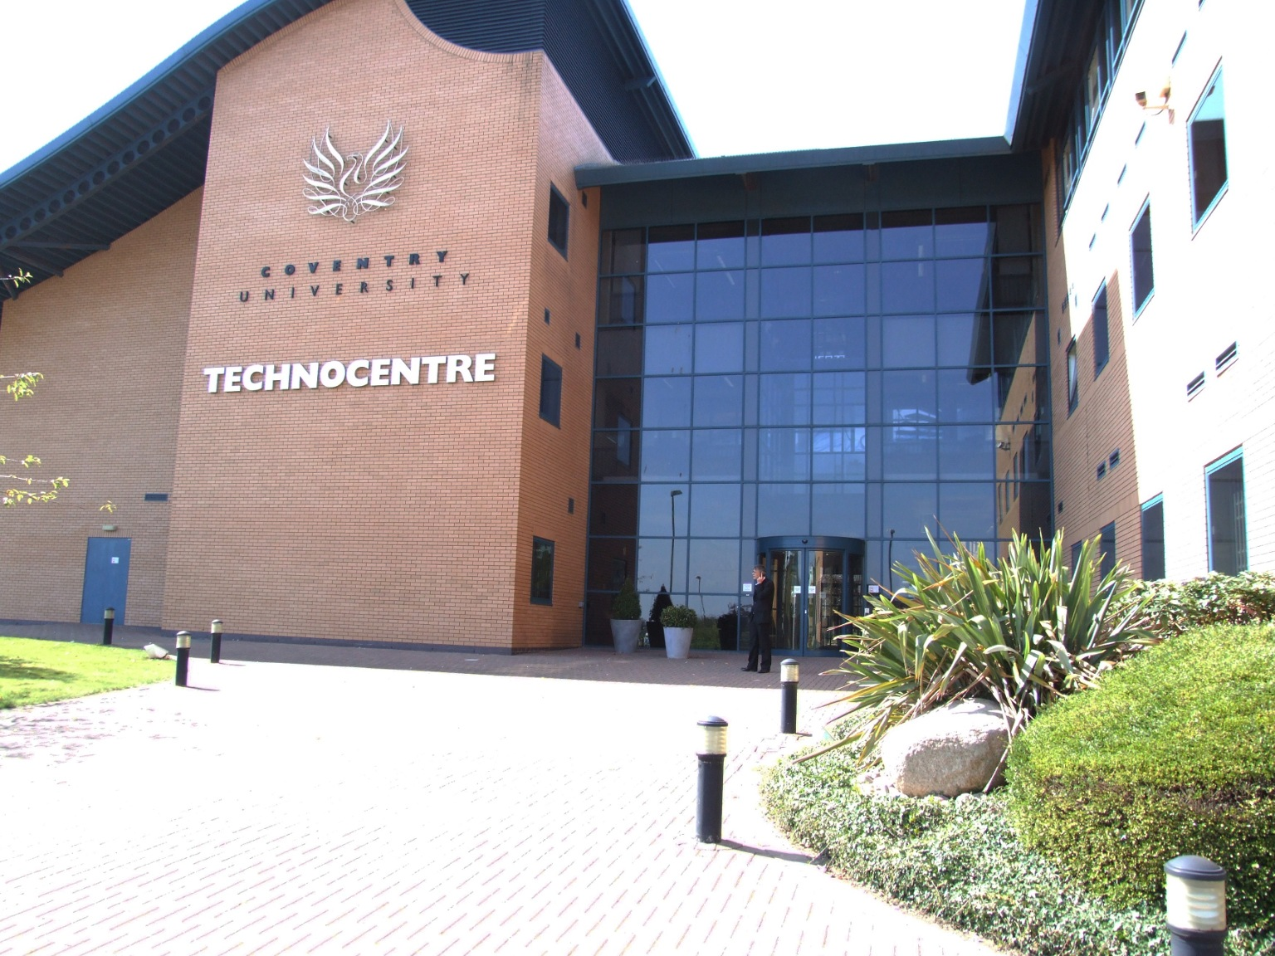
Introduction
PyCon UK is UK’s only national Python language conference
Held at TechnoCentre in Coventry for third year running
Coventry centrally located on UK road network
Ten minutes walk from Coventry train station

Slide 4
Conference information
4-day conference (Fri Sept 20th – Mon Sept 23rd)
Approximately 200 attendees
Early-bird tickets £99, standard tickets £150
TechnoCentre main room held approximately 150 people
Three parallel sessions over first 3 days
Canteen with lunches provided, free coffee all day and mezzanine chill-out balcony with sofas

Slide 5
Conference information
All attendees provided with customised PyCon UK mug and t-shirt
Friday night pub social with sponsored drinks
Saturday night conference dinner included in ticket price
Education track on Saturday with teachers attending
Raspberry Jam on Sunday with kids attending

Slide 6
Friday sessions
Keynote by David Mertz - “What I learned about Python”
Regional groups forum
Distributed Hash Tables
Deployment tools
Ansible
Testing talk - “Breaking things for money”
pyOpenSSL
Testing madness

Slide 7
Saturday sessions
All day education track
Mining Python software
Validating documents with Python and Ming
Python adventures in startup land
Cooking up high-quality software
Physical turtle module and turGLes
Redacted history of censorship

Slide 8
Saturday sessions
Web scraping to teach data science (RSWA)
Keynote - “Introduction to the Python Software Foundation”
Social media analysis with NLTK
BDD with Python Behave
Virtualisation with Ganeti

Slide 9
Sunday sessions
Sunday had no talks
Special interest groups – Python on Free Desktop, Python C API, PyRoom 101, Python and JavaScript, Web Special Interest Group
“Don't be afraid to commit” tutorial
All-day Raspberry Jam meeting in separate building
Python Panel discussion
AGM and conference feedback

Slide 10
Lightning talks
Limited to 5 minutes only
Chaired by “Lightning Talk Man” Harald Massa
Full audience with good atmosphere
Variety of topics – Tag Trees, VAT changes, “You are a brain”, Kivy, avoiding itertools, ICT curriculum help, eGenix Run, SOLR, Twisted
Best lightning talk on Ubiquitous Larch – fully live shared programming env from Python Anywhere

Slide 11
Education track
Smithy AKS using Minecraft to Control a Quadcopter at PyCon UK

Slide 12
Monday development sprints
Final day dedicated to development sprints
Around 40 people stayed for sprints
Sprints on Kivy, Turtle, Django, Python core dev, open data water quality, Twisted, educational tools
Most teams coded in same room
Django sprint had 10 people led by core contributor
Django devs available on IRC
Easier Django bugs left for sprint

Slide 13
Conclusions
Well attended conference
Lots of variety in talks and special interest groups
Education track and teachers in attendance
Raspberry Jam very busy
Beginner tutorials helpful
Great energy at development sprints
Great value conference
PyCon UK 2014: Sept 19th – 22nd 2014, Techno Centre, Coventry

